Slide 1

Social Books Web Application
Presented By:
Awais Akbar, Yang Wang, and Karthick Pandi,
Department of Computer Science
Maynooth University, Ireland
Maynooth, Co. Kildare, Ireland

Slide 2
Outline
Part – I
Introduction
Technical Architecture
Technologies Used
User Stories
Part – II
Use Case Diagram
Web App Architecture
User Interaction
Responsive Web Design
Part – III
Cloud Deployment Architecture
Agile Ideas for Project Management
MongoDB Blackmail Issue

Slide 3
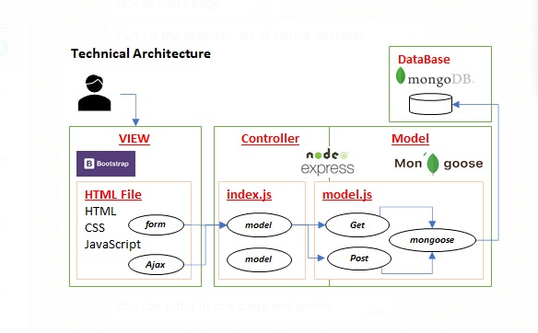
Technical Architecture

Slide 4
Technologies Used
Front End
HTML/CSS + Bootstrap Framework + Java Script
Back End
API Service Layer - Express JS/Node
ODM - Mongoose
Database
Mongo DB

Slide 5
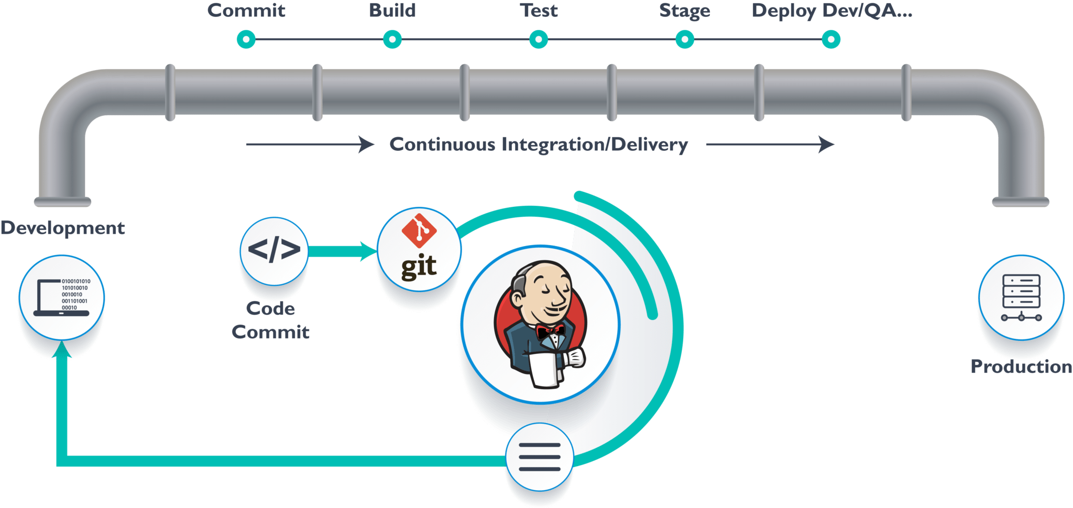
Jenkins
Automated Software Development Process
Used for Continuous Integration & Continuous Delivery
Continuous Integration
Will Check any breakage if new commits were made
into the main branch
Continuous Deployment
Starts when CI gets done
Deploy changes to the testing environment

Slide 6
User Stories
User Management :
Registering with the username and password for portal login
User can able to login into book portal.
Able to Reset or Change password
Adding Books :
Title, Author, Year, Abstract, ISBN , Personal tags are used for books adding

Slide 7
User Stories
Personal Section
Books in Personal Library can be viewed basic on topics/metadata tags.
Each books relate to a topic
All books under the topics are getting listed
Social Section
In Social section where recommendation happens if they share at least three books in common.
Nothing we can know about the user other than the books which he is interested.
Book Management
User can able to Select , Update, Delete and search the books from the library portal.

Slide 8
PART - II

Slide 9
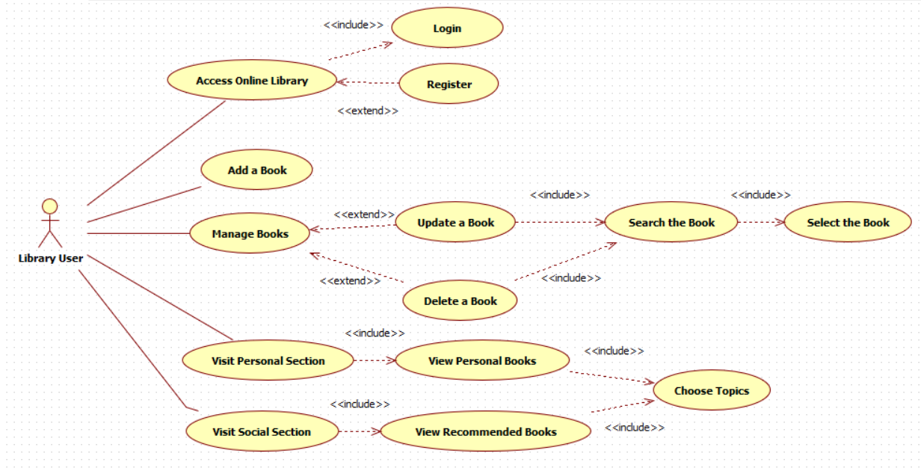
Use Case Diagram
Access Online Library
Register
Login
Add a Book
Manage Books
Search Book
Select Book
Update Book
Delete Book
Visit Personal Section
Choose Metadata Tags
View Personal Books
Visit Social Section
Choose Topics
View Recommended Books

Slide 10
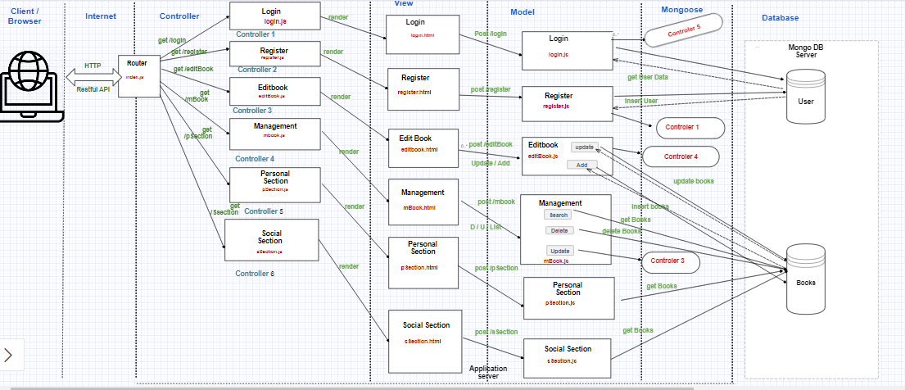
Web App Architecture
Used MVC
To separate app into 3 components:
Logic, Interface, Database
Model
Shows MongoDB data model of our library app
Constraints & formats to store data e.g JSON format
Represents collections e.g., user, books
Stores a book when user’s request passes through controller to model
View
Presents data to the users using .html files e.g., viewing personal or social library books
Controller
Controls users’ requests
Generates appropriate response
Gets triggered when user passes any request e.g to view a book

Slide 11
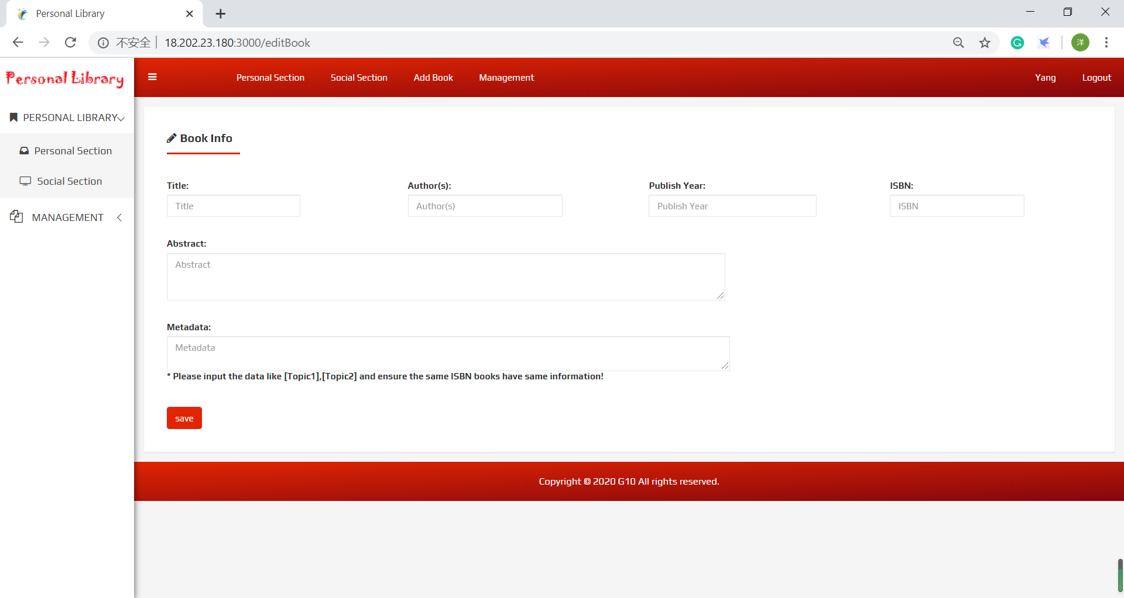
User Interaction – Personal Section
ISBN Validation
Book not added in case of invalid ISBN
Accepts both 10 & 13 digits ISBNs
Used JavaScript regular expression to validate ISBN
Register
Examples of one 13 digit accepted ISBN: 978-1-4842-3896-7
Examples of one 10 digit accepted ISBN: 0-13-187248-6
Metadata
Can add more than one metadata tags/ topics
Accepted Format : [Topic 1], [Topic 2]

Slide 12
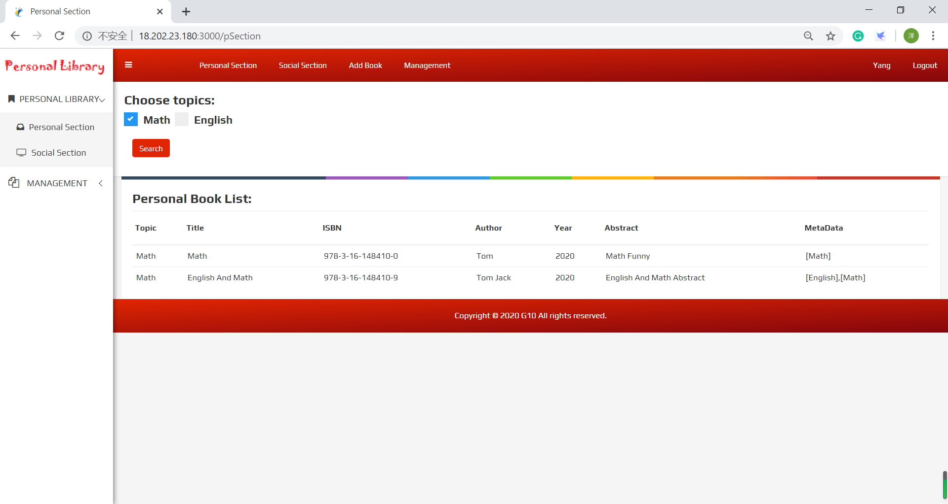
User Interaction – Personal Section
Shows the list of books in personal library
Topics / metadata tag can be selected for viewing books

Slide 13
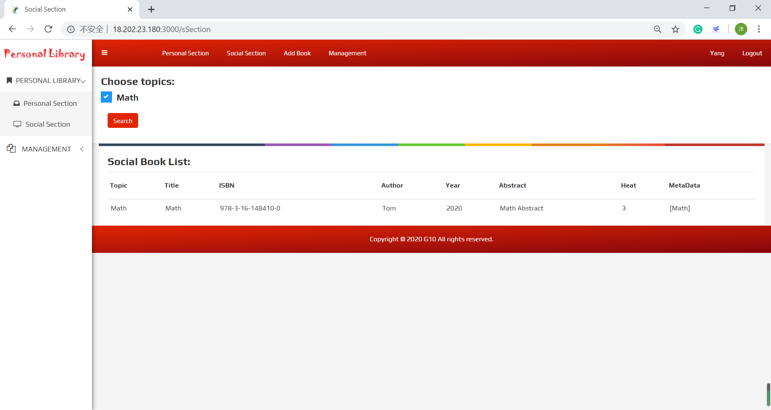
User Interaction – Social Section
Shows the list of books in personal library
Topics / metadata tag can be selected for viewing books

Slide 14
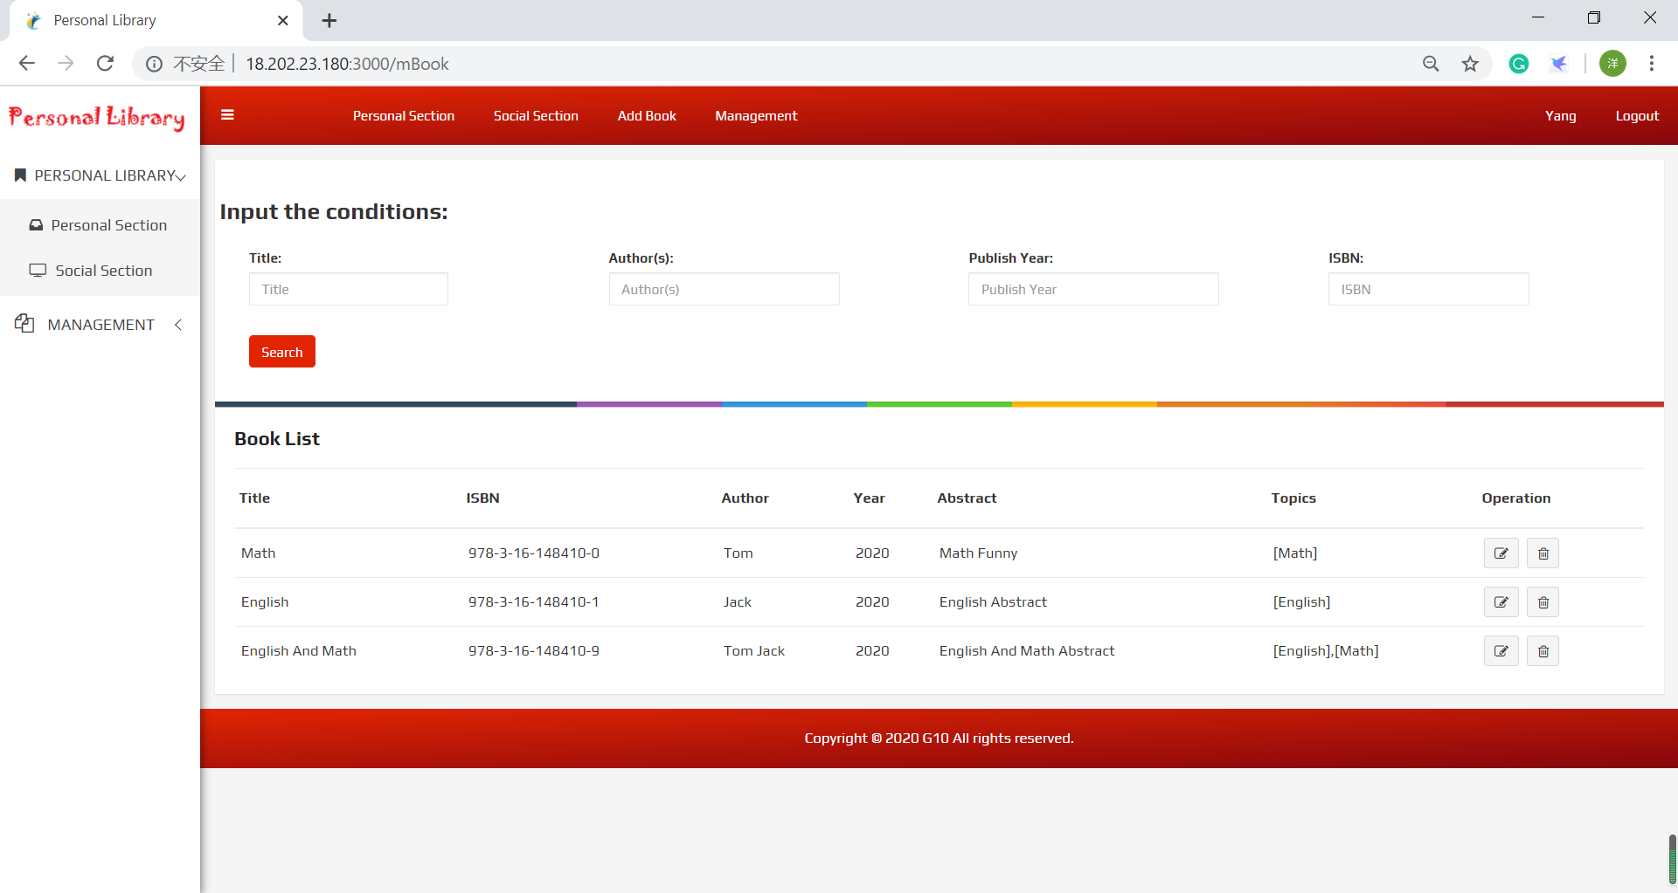
User Interaction – Book Management
Different Operations can be performed on personal library
Search books
Deleted Books
Edit Books

Slide 15
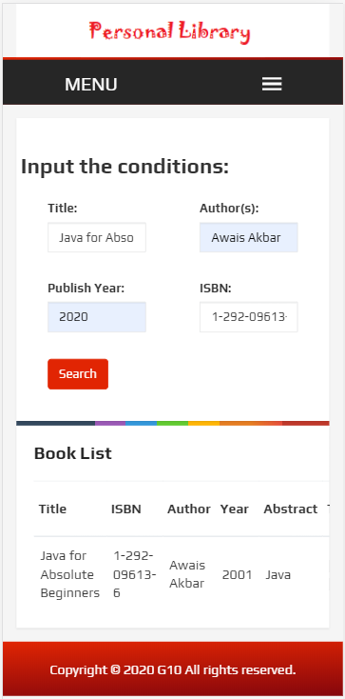
Mobile-Friendly (Responsive) Web Design
Used CSS @media rule
Includes a CSS properties block when a particular condition is met
Layout changes depending on the device
Doesn’t require zooming to make the text readable
Works well on mobiles and tabs

Slide 16
PART - III

Slide 17

Cloud Deployment Architecture
Used AWS to deploy the App and Db Servers
1. Available Zone:
Used Two AZ to deploy the servers on two physical data centres.
(Europe (Ireland) eu-west-1 and Europe (London) eu-west-2)
2. Private Subnet(EC2):
Deployed different type servers on separate subnets and EC2.
Controlled with security groups from IPs, Protocols and ports.
3. Application Load Balance:
Optimized the use of resources and avoid overload.
4. Auto Scaling:
Improved fault tolerance, availability and reduce the cost.
HTTP Request
AWS Deployment Architecture
VPC
Amazon
Load Balance
Available Zone
Available Zone
Subnet
Subnet
AutoScalling
Group
EC2
EC2
WebApp Server
WebApp Server
Subnet
Router
EC2
Mongo Db

Slide 18

Agile ideas for Project Management
Development and Deployment Architecture (CI/CD)
Used some agile ideas to manage the project.
1. Requirement Analysis:
Divided all functions into small modules to be suitable for Agile management.
Every module was managed by separate JavaScript and HTML file.
Used Restful API to access each module and plugged in or out freely.
2. Team Management:
Used the team structure (Scrum master + 2 members) to ensure the progress and quality.
Operated the start-up, preview and review meetings every week to manage the progress and risks.
3. CI/CD - Continuous integration and continuous delivery:
Used the Git and Jenkins to manage all project phases to deploy the services on servers automatically.
Development Env
(IntelliJ IDEA + Git)
GitHub Server
(GitHub.com)
DevUT
Source
Push
Source
Deliver
Deployment Server
(AWS EC2)
Tomcat:
Jenkins Server
IT
Source
wars
Build
wars
Publish

Slide 19

The blackmail trouble of MongoDB
1. Trouble:
Several times we found that the data has been deleted from our database,
and received a mail to let us pay Bitcoin to recovery the data.
2. Reason:
To use the local tool to manage Database, We exposed the server on the public subnet.
However, the default configuration of MongoDB does not have any security policy,
the hackers can scan the database port(27017) to operate the database remotely.
3. Solution:
Moved the MongoDB into private subnet, and closed the port(27017) to avoid the access from Internet.
Meanwhile, added new policies to limited the unnecessary access.

Slide 20


Thanks for your attention

